Slide 1
Intro to JavaScript (JS)
Not Your parental figure’s Javascript
Mark Brown II & Natassja Linzau (TA)
Featuring Beyonce
Notes:
REMEMBER TO OPEN CONSOLE and JSBIN in the same window
How many of you are familiar with JavaScript?

Slide 2

Who IS Mark Brown II?
Front-End Developer
Department of Commerce
Commerce Data Service
Lover of NodeJS
Practitioner of Crossfit
Student of Higher-Education Policy
Worshipper of Beyonce
Notes:
Photo Credit: http://www.hercampus.com/sites/default/files/2015/07/23/p18srdu43i1nfib54t5eqv61pet4.jpg

Slide 3
Commerce Data Academy
A data education initiative of the Commerce Data Service (CDS).
• Launched by the CDS to offer data science, data engineering, and web development training to employees of the U.S. Department of Commerce.
• Course schedule and materials (e.g. slides, code, papers) produced for the Commerce Data Academy can be found on our website at http://dataacademy.commerce.gov .
• Questions? Feel free to write us at Data Academy (dataacademy@doc.gov)
Notes:
You all are here b/c you are taking a course through the Commerce Data Academy - whose purpose is to offer courses on various topics in data science, development, and engineering for Commerce employees.
No need to write down the links - this presentation will be sent out after this course and will be hosted online as well.

Slide 4
Course Files
Today’s code can be found at:
https://github.com/maabrown/JS_Class_Sept_2016
Notes:
Leave this up for a second. It should have been emailed to you.

Slide 5

GOALS
Understand Front-End vs. Back-End
Learn JS data types
Recognize Arrays vs. Objects
Implement Looping
Write Functions
Notes:
Credit: https://giphy.com/gifs/foxsports-football-soccer-futbol-Qw4X3FCYb9sflH9HgBO

Slide 6

MAKE A FRIEND!!
Notes:
Stand up - Turn to the person on your right – or left – say your name, where you work, and your favorite type of cheese – or if you’re lactose intolerant, what kind of snack you enjoy – 2 min!
Credit: http://giphy.com/gifs/friends-rachel-green-tv-VZXuygf0oUb5u

Slide 7
Front End vs Back End
What is Front-End Engineering?
Development of client / browser code
Languages: HTML, CSS, JavaScript
Typically what the user sees and interacts with
What is Back-End Engineering?
Development of server-side code
Handles things like routing, data handling and databases
Languages: Ruby, Python, Java, NodeJS, Express
Stuff "behind the scenes" that makes web applications work
Notes:
House analogy: Drywall is HTML, Paint inside is CSS, JS is the door handles, windows --- plumbing and electrical are server-side backend code
Routing - commerce.gov isn't commerce.gov/blog which isn't commerce.gov/image or commerce.gov/image/kitten
Data handing - online forms - makes sure it gets to database securely, data validation (name is made of letters, phone number is a phone number etc.) - databases: when you shop on Amazon and close browser when you come back your cart is still there

Slide 8
History of JavaScript
Created in 10 days in May 1995 – Brendan Eich (Brave Software)
Originally called Mocha → LiveScript → JavaScript
Standardized in 1996-1997 (via ECMA)
Official Release ECMA-262: ECMAScript → ES
Mostly used in web browsers
Web engines: V8 (Chrome, Opera), Nitro (Safari), SpiderMonkey (Firefox), JScript 9.0 (IE)
Notes:
Eich – said like ’Ike’
Move to JS was done as a marketing move since Java (another programming language – used to build Gmail and Blue Ray Discs)
ECMA – European Computer Manufacturers Association
ECMA is a standard by which JS must abide. JS is an implementation of ECMA - but isn't ECMA. There are things that JS does that ECMA doesn't require.
ES5 runs in the current browsers
ES6 needs a compiler (Babel)
Credit: https://www.w3.org/community/webed/wiki/A_Short_History_of_JavaScript
Credit: http://stackoverflow.com/questions/912479/what-is-the-difference-between-javascript-and-ecmascript

Slide 9
TO BE CLEAR
JavaScript = JS
ES is a standard
JS is an implementation of ES
Versions of JS are sometimes called ES + version number
ES5 (current)
ES6 (latest)
Notes:
There are other implementations of ES such as ActionScript and JScript

Slide 10

LETS GET TO IT!
Notes:
Credit: https://giphy.com/gifs/beyonce-moments-dial-I8XaJ6ZEFHI3u
As we go through this do not hesitate to stand up and walk around. Sitting for 3 hours isn’t fun – I won’t be doing it sooooo you shouldn’t have to either!

Slide 11
Informative Conversation Statements
THERE ARE NO STUPID QUESTIONS!
ASK QUESTIONS OFTEN!
PLEASE CODE-ALONG WITH ME!
I ❤️ QUESTIONS!
Notes:
I may not always know the answer but we can explore together.
IN FACT – ASK ME A QUESTION RIGHT NOW! ANY QUESTION!

Slide 12
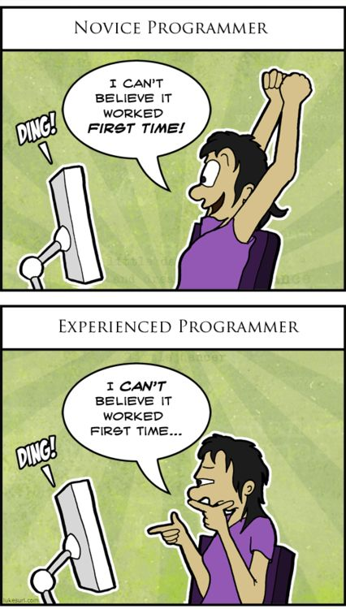
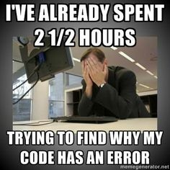
Our Agreement (Repeat After Me)
I am going to make mistakes.
I am going to get things wrong.
I am going to fail.
This is okay!
Notes:
1st picture is extastic
2nd picture is suspicious

Slide 13

Getting Started
Download code from repo https://github.com/maabrown/JS_Class_Sept_2016
Find folder on your machine using ‘Finder’ (Mac) or ‘Windows Explorer’ (PC)
Open folder (directory) in Code editor – Sublime, Atom, or other of choosing
MAC
Drag icon of ’index.html’ file to your web browser icon
PC
Double-click index.html (or index)
Notes:
Everyone needs the repo for an exercise we are doing later in the lesson
Windows Explorer is the icon

Slide 14
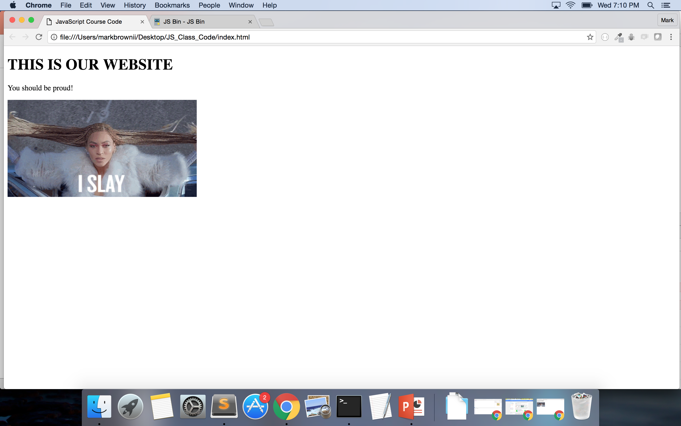

Slide 15
2 OPTIONS
Console on your web browser (Going over this option first)
OR
JSBin.com (This option second)

Slide 16
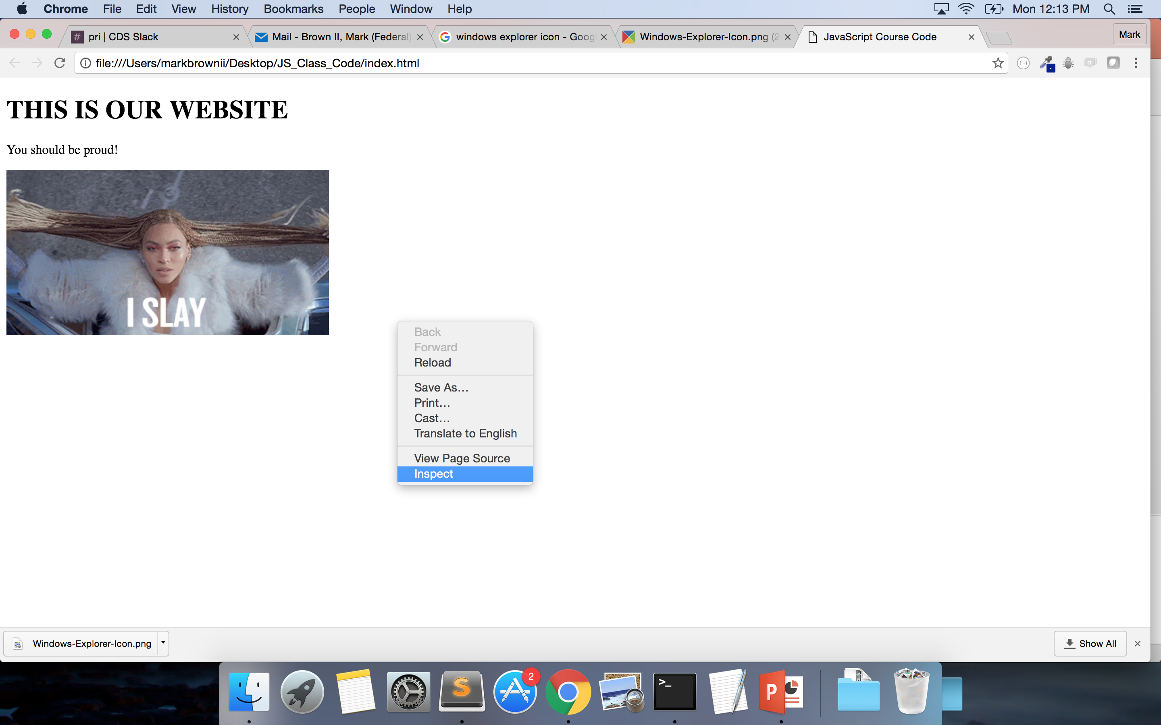
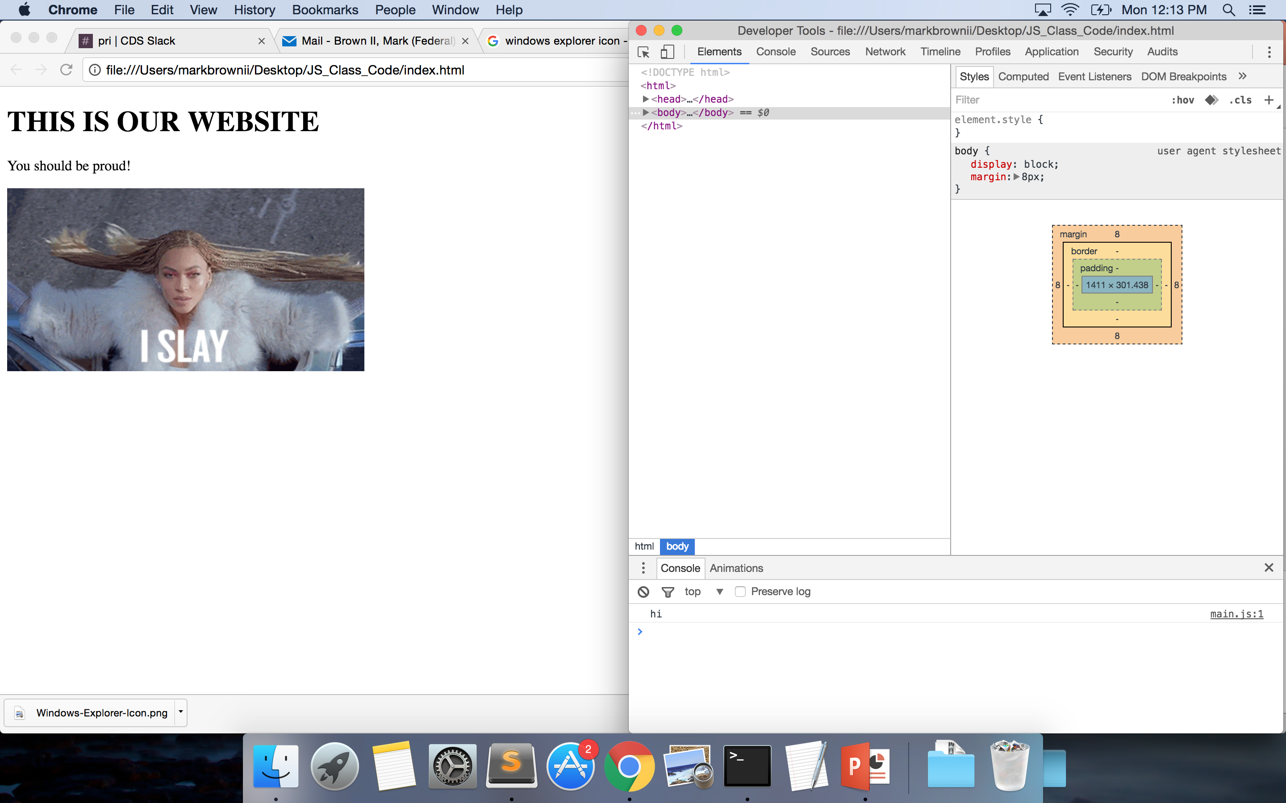
Developer Tools (on Chrome)
Right click page
Select Inspect
Notes:
Firefox – Inspector
Opera – Dragonfly
We won’t be working with the HTML and CSS today so feel free to make your console bigger.
PAUSE HERE IN CASE SOMEONE GETS LOST – Go through it quickly

Slide 17
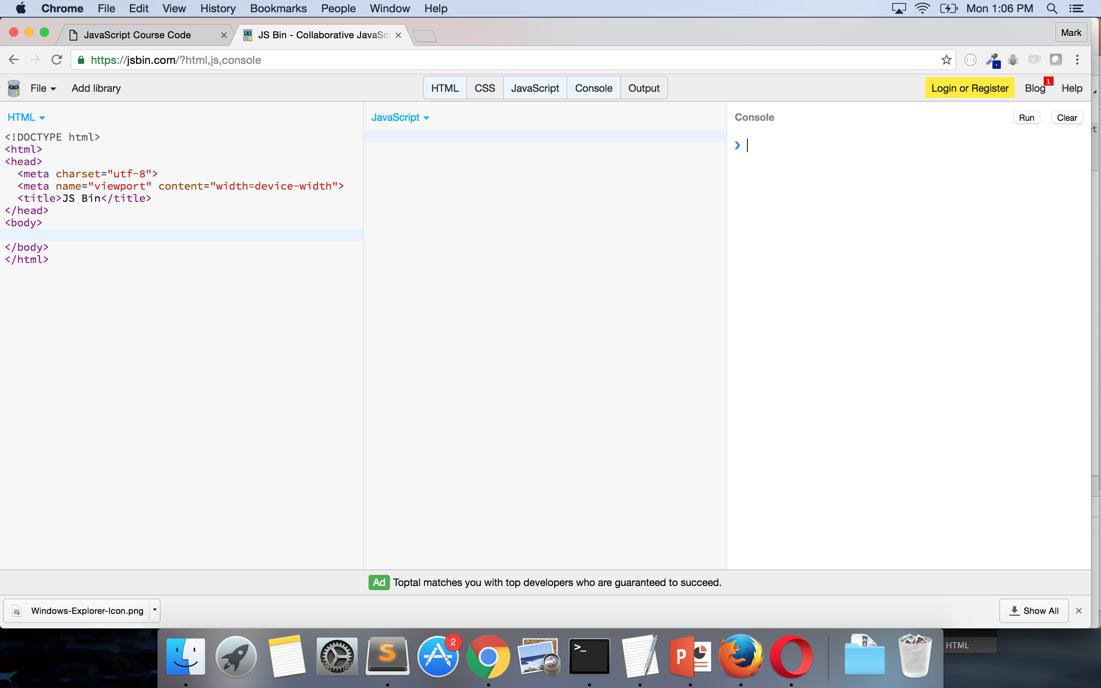
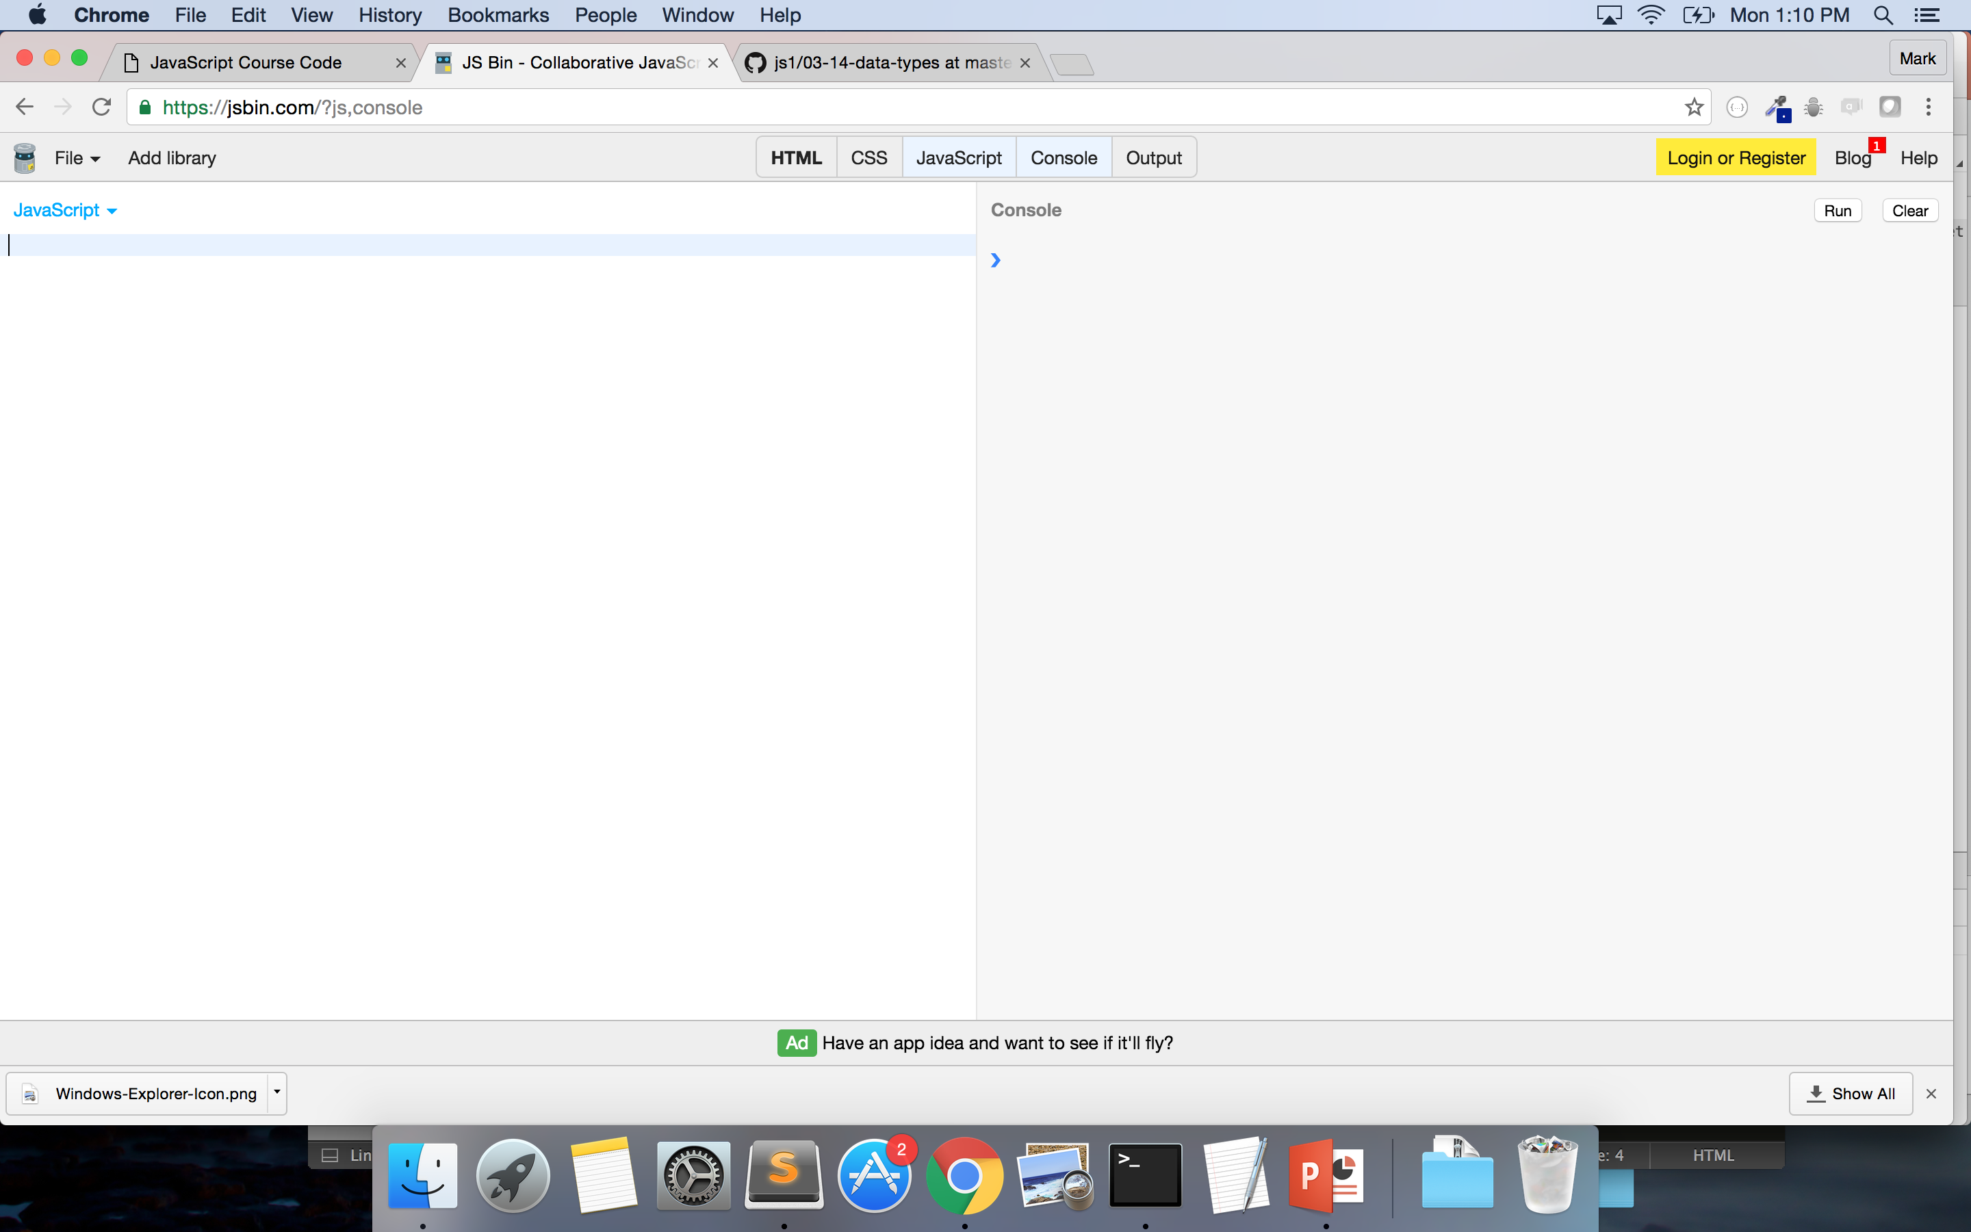
JSBin.com
Go to JSBin.com
Select ‘JavaScript’
Select ‘Console’
Unselect ‘Output’
Unselect ‘HTML’
Notes:
GO THROUGH THIS ON YOUR COMPUTER AS WELL!
Is everyone good??? THUMBS UP OR THUMBS DOWN!

Slide 18
Data Types
What is a data type?
It is a classification identifying one of various types of data
7 Types of Data:
String
Number
Boolean
Array
Object
Null
Undefined
Notes:
Credit: https://en.wikipedia.org/wiki/Data_type

Slide 19
STRINGS
Textual data
MUST Surrounded by double (sometimes single) quotes
Consists of characters
Spaces are characters
Zero-indexed (which includes spaces)
Examples:
”Hello”
“5”
“{ key: value }”
“kittens”
Notes:
Spaces are characters in strings – space between curly brace and k in key is a character
H’s index is 0
What is e in ‘kittens’?

Slide 20
What do you mean ‘zero-index’?
Each character has an index
Computer uses index to reference the character
Index starts at zero (rather than with 1)
KITTEN (K’s index is 0)
KITTEN (I’s index is 1)
KITTEN (E’s index is 4)
Test Yourself:
”Single Ladies”
1. What is the index for g?
2. What is the index for a?
3. Does the space have an index? If yes, what is it?
4. What is the index of the first s?
5. What is the index of the second e?
Notes:
3
8
Yes, 6
0
11

Slide 21
NUMBERS - INTEGERS
Whole numbers – no decimals
Does not have a delimiter (a character that is used as a boundary in a data stream) – e.g. “,”
NaN is a number
Examples:
42
-3
10000000000000000
Notes:
Credit: https://en.wikipedia.org/wiki/Delimiter

Slide 22
NUMBERS - FLOATS
Numbers with decimals
No delimiter
Examples:
4.5
-1.333333333
5968332244.33324
3.141592
Notes:
Can anyone tell me what 3.141592that is?

Slide 23
BOOLEAN – NULL - UNDEFINED
Boolean
Values of ‘true’ or ‘false’
Undefined
Variable without a value
Null
Essentially something that doesn’t exist
Notes:
Credit: http://www.w3schools.com/js/js_datatypes.asp
We will discuss

Slide 24
ARRAY
Ordered collection of data
Can have mixed data types
Delimiters used:
[] – to open and close an array
, - to separate items within an array
Examples:
[3, 2, “hello”, {}, 4.555555, true] ← One array
[“hello”], [37, 91] ← Two arrays
[ [3,2,”hello”], 45, “laugh”] ← One array but an array within an array
Notes:
As in math - the brackets work like parenthesis

Slide 25
OBJECT
Unordered collection of data
Can have mixed data types
Key-value pairs
Delimiters used:
{} – used to open and close objects
: - used to separate key from value
, - used to separate different objects and key-value pairs in objects
Examples:
{name: ”Beyonce”, num_of_awards: 195}
{albums: [‘Bday’, ’Dangerously in Love’, ‘Lemonade’]}

Slide 26
OPERATORS
Know most from math
-
Subtracts numbers
/
Divides numbers
*
Multiplies numbers
+
Add numbers, concatenates Strings
%
Returns the remainder from the division
Notes:
Does anyone know what the modulus does?
SPEAKING: "he" + "llo" = "hello"
Go to jsbin or console and show examples
Make sure to do string subtraction – console.log(“hi” – “i”) → NaN
Returns NaN because of JS coercion!
When JS sees that math is being done, tries to convert the strings to numbers – which they aren’t – and thus gives NaN
Another example: console.log(5 + “3”) returns “53” – JS converts 5 to a string and then concatenates since 3 was a string
We see 3 as a number with quotes but the computer just sees it as a string regardless of it being a number in between the strings and since you can’t do math on strings it makes 5 a string – You and the computer are different

Slide 27
Console.log - typeof – charAt()
Console.log()
Is a function
Returns the value given to the function
Put the computation you want in between the parentheses -- console.log(“hello”);
typeof
Is an operator
Tells you the data type of an input
Type ‘typeof’ – give it a space – put the value you want to evaluate -- typeof {}
charAt()
Built-in method
Tells you the character at a given index
Write out the string you want using “ “ and then use .charAt(index-you-want) -- “Video Phone”.charAt(7)
Notes:
Built-in: Functions (which we will discuss later) that are native to JavaScript
Native means that you don’t have to write any code to use them
MUST USE CONSOLE.LOG ON JSBIN!!!

Slide 28
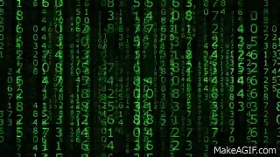
CODE-ALONG!
Notes:
DO CODE IN JSBIN – NOT THE CONSOLE!
ALWAYS END STATEMENT WITH SEMICOLON!
MUST USE CONSOLE.LOG ON JSBIN
Console.log(“Mark”);
Console.log(65);
Console.log([4,7,10]);
Console.log(Mark); → so they see that it gets ‘undefined’
Console.log(typeof Mark);
Console.log(typeof 65);
Console.log([4,7,10]);
Console.log({ ’key’ : ’value });
Console.log(3+5);
Console.log(7*10);
Console.log(9 % 5); → 4 -- Think of it as 9 % 5 with a remainder of 6
-- can be used to see if a number is even or multiple of particular number
-- Console.log(any-number % 2) = 0 is event
-- Console.log(any-number % 3) = 0 is multiple of three
Console.log(“Mark”.charAt(0));
Console.log(“rango”.charAt(3);
Credit: https://giphy.com/gifs/gh-C6UVM5TbW1Y2s

Slide 29
YOUR TURN! (5 min)
Using JSBin or the Console do the following:
Use console.log to:
Write your name
Write the name of your favorite city
Write the number of days in the week
Write any array with 3 days of the week
Write an object with the following key/value pairs:
Rose: Red, Violets: Blue, Cosmos: Purple
Use ’typeof’ to see the types of each of the above
Use console.log to:
Multiply 8 by 5
Add 10 to 6
Figure out if 198874 is a multiple of 7
Use charAt to evaluate the string “Run The World”
What character has the index of 4?
What character has the index of 9?
Notes:
Credit: https://giphy.com/gifs/typography-GqDZqVjH4XFFC
Also use this time as a break!

Slide 30
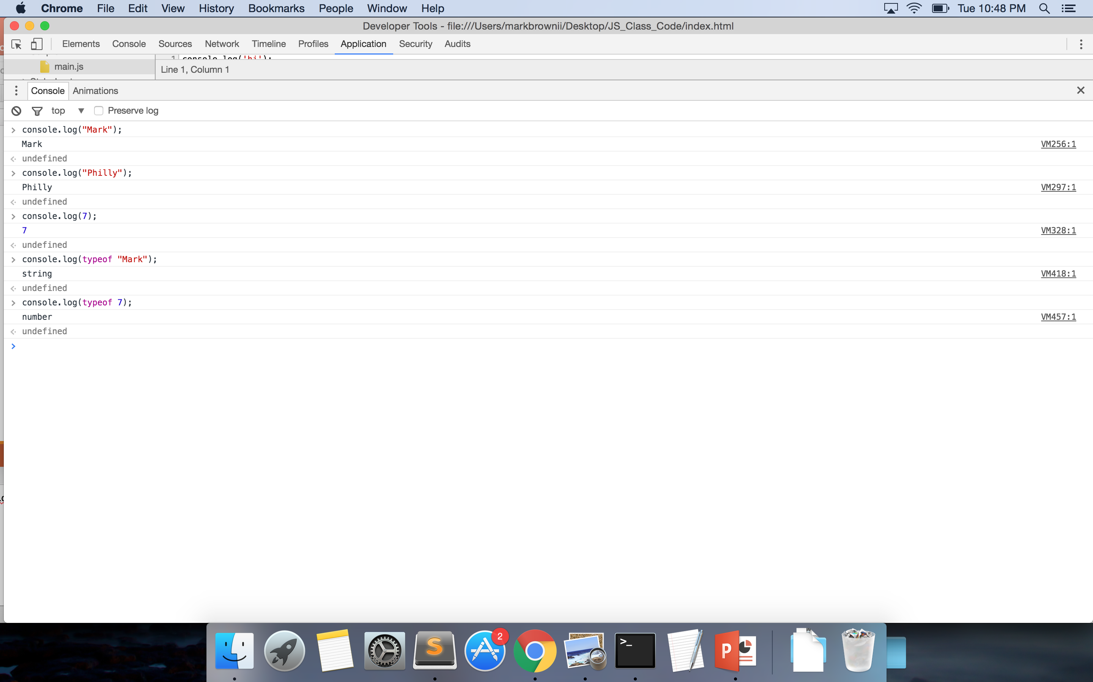
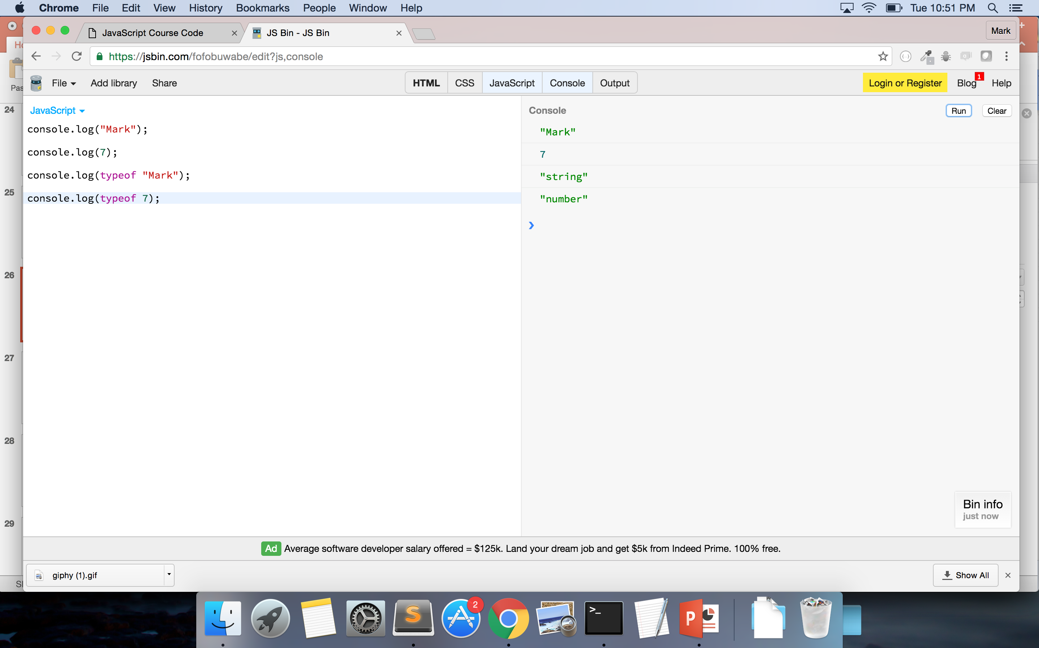
Console & JSBin

Slide 31

POP QUIZ!!
1. What is Front-End engineering?
2. Are JavaScript and ES equivalents?
3. What are the differences between Integers and Floats?
4. Is “5” the same as 5?
5. ‘True’ and ‘False’ are what type of data?
6. What are the differences between an array and an object?
7. True/False: I can have mixed data types in my array.
8. How can I check a datatype using my computer?
9. What does ’charAt() do? Is it native to JS? Why?
Notes:
Credit: https://giphy.com/gifs/m4QebXYgrWGkw

Slide 32
VARIABLES
Used to store information to computer’s memory for future use
Declaring
Always use keyword ‘var’
var myName
Assigning
Can assign variables any value – including arrays, objects, functions
var myName = “Mark”;
Always use a “;”
Calling
How you access the variable’s value
Use variable name – not the value
Returns ‘undefined’ if variable isn’t assigned a value
Notes:
Mention camelCase or _underscore – consistency is key
Check with framework – sometimes _underscore can have implications in your code
Go to Console and do:
var a
Var a = 5;
A
If using JSBin – you must must declare and assign variable outside of console.log() – you can console.log to call the variable
If you don’t declare and assign – console.log will tell you it is not defined

Slide 33
WHAT DO YOU MEAN BY ORDERED?
Arrays
Each piece of data has an index (order-value associated with it)
Is zero-indexed (first item has the index of 0)
Similar to Strings!
Objects
Pieces of data are not indexed
Data based on key-value pairs

Slide 34
ARRAYS (cont.)
Store data
Consists of ‘elements’
Zero-indexed (index starts at 0)
Data can be added, deleted, and changed
To get the value in an array:
arrayName[index]
var names = [‘Beyonce’, ‘Bey’, ‘Yonce’];
names[0] = ‘Beyonce’
names[2] = ?
var sailorNames = [‘Moon’, ‘Jupiter’, ‘Mars’, ’Venus’, ‘Mercury’];
sailorNames[2] = ?
sailorNames[0] = ?
sailorNames[3][0] = ?
sailorNames[1][6] = ?
Notes:
is there a variable on this slide? yes - how do you know?
what is the name of the first variable on this slide?
is the variable declared? why?
is it assigned? why?
the value is what data type? and how do you know it is that data type?
what is the first element in the first array? Second element? third?
how do you know it is the first element?
Due to index – do you understand why order is important?
Use JSBin to do:
var dsNames = [”Kelly”, “Michelle”, “Beyonce”]
Console.log(dsNames.length)
var memberName = dsNames[1]
memberName
Can use the keyword ‘new’ so var newArray = new Array(‘things’, ’to’, ’do’); - but not seen as best practice

Slide 35
ARRAYS – Built-in Methods
Methods you can use with arrays:
Slice();
Reverse();
toString();
length
Other methods: https://developer.mozilla.org/en-US/docs/Web/JavaScript/Reference/Global_Objects/Array
Notes:
What does built-in mean again?

Slide 36
CODE-ALONG!
Notes:
ALWAYS END STATEMENT WITH SEMICOLON!
var names = [‘Beyonce’, ‘Bey’, ‘Yonce’]
var newNames = names.split(0,1); → [‘Beyonce’]
var newNewNames = names.split(0,2); → [‘Beyonce’, ‘Bey’]
Console.log(names.length);
Console.log(names.reverse());
Console.log(names.toString());
Credit: https://giphy.com/gifs/gh-C6UVM5TbW1Y2s

Slide 37
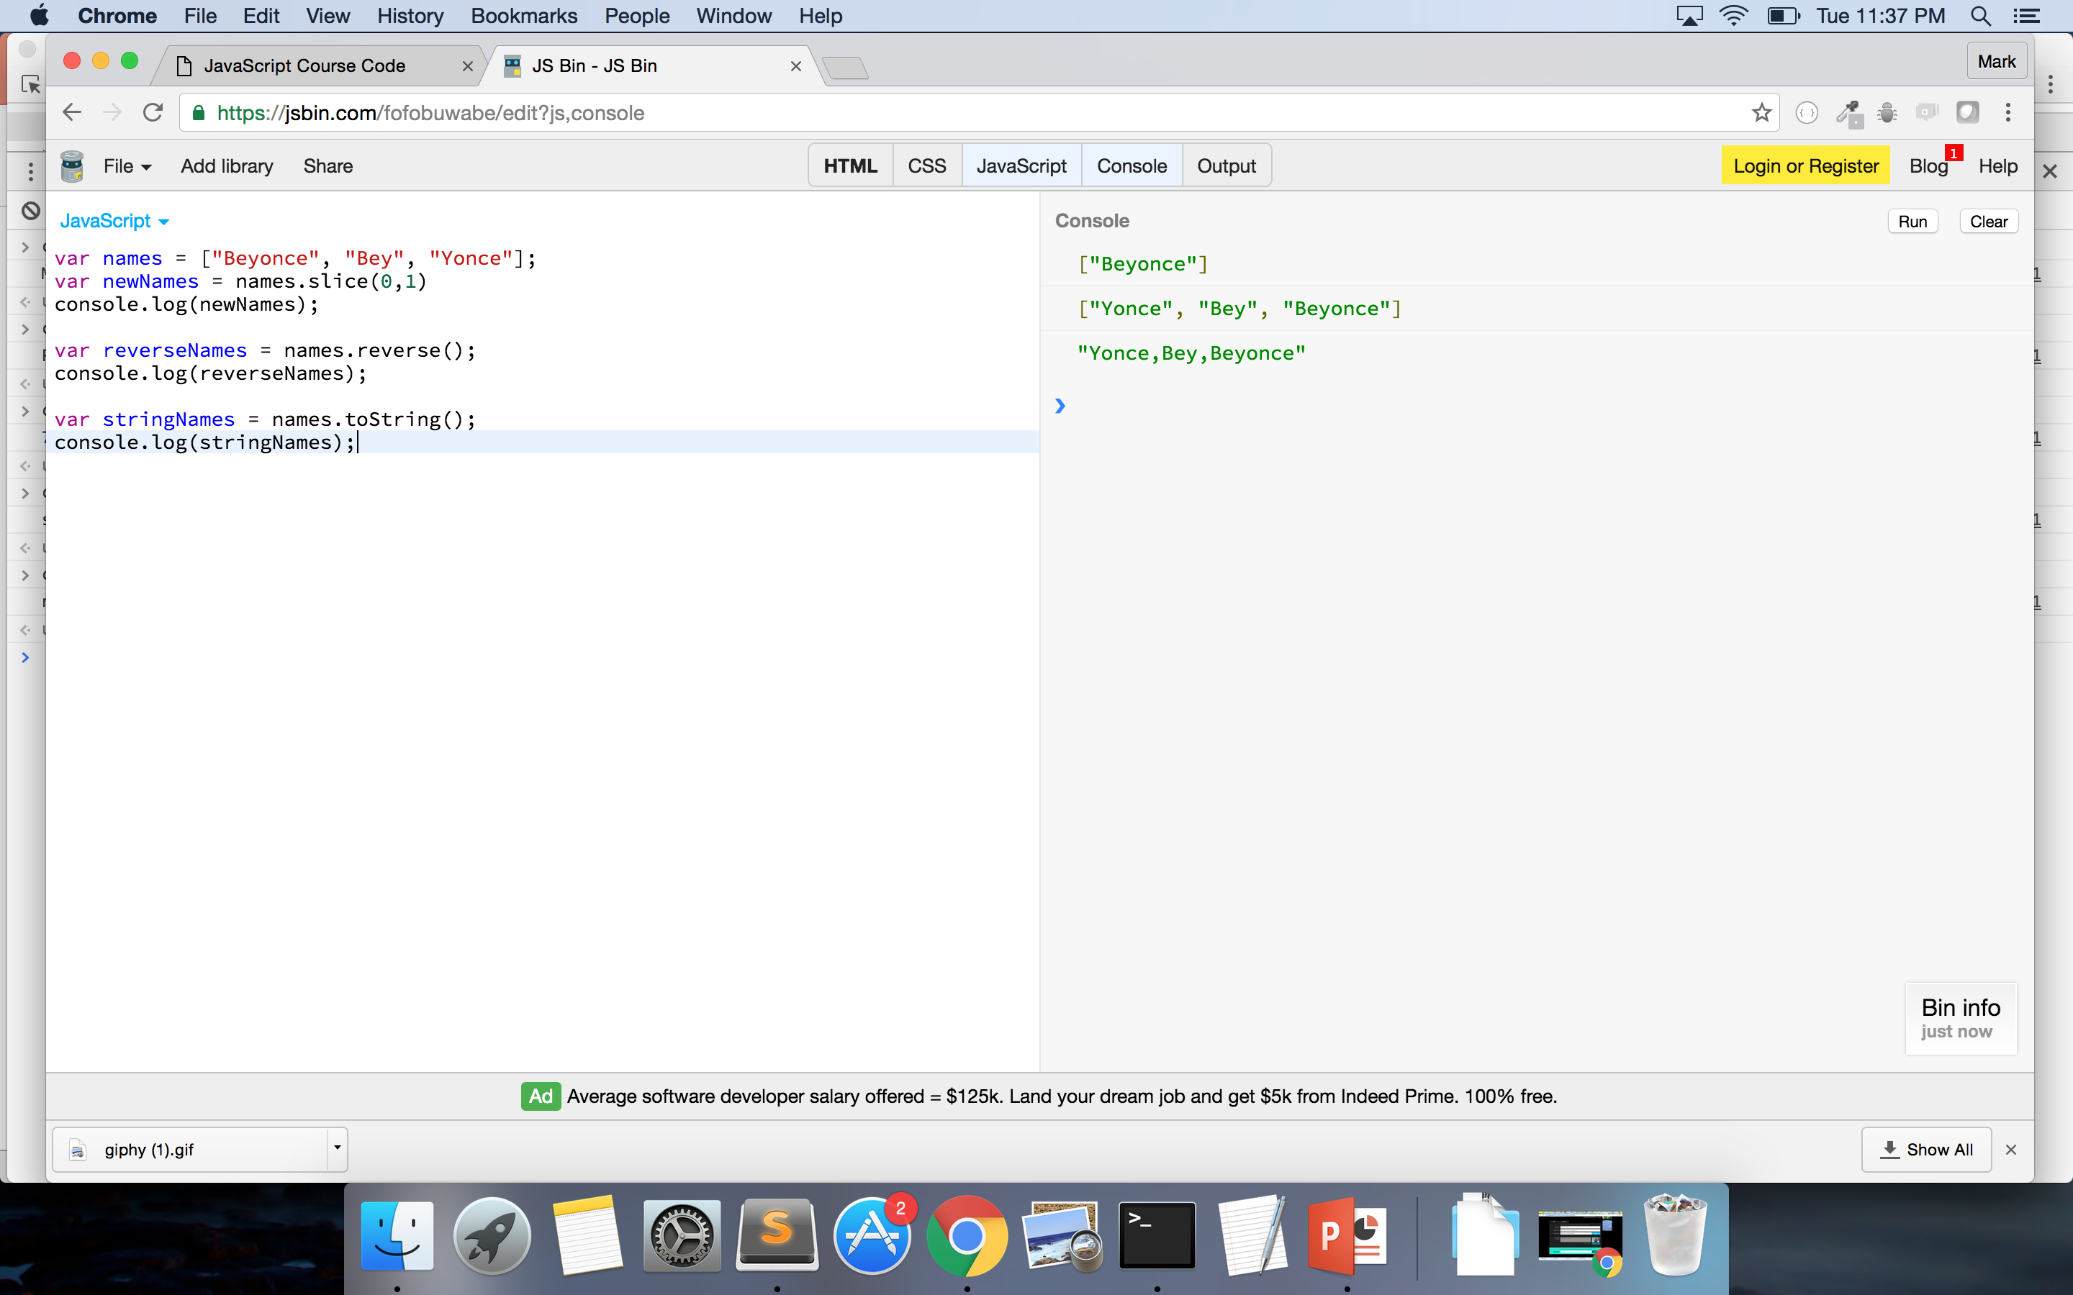

Slide 38
OBJECTS (cont.)
Store data
Consists of ‘key-value’ pairs
KEY: VALUE
Data can be added, deleted, and changed
Order does not matter - indexed by the ‘key’
Access values 2 ways:
objectName[key] = value
newObject[name] = ”Mark Brown II”
newObject[“position”] = ?
objectName.key = value
newObject.employer = ?
var newObject = {
name: ”Mark Brown II”,
position: “ Developer”,
employer: “Department of Commerce”
}
Use “ “ when key has number or other special characters
Use same notation to add key/value to object
newObject.hair = “natural”
Notes:
Keys can be numbers but you can’t use them without using double quotes “ “ and you can’t use . (dot) notation

Slide 39
MORE PRACTICE
var newObject = {
name: ”Mark Brown II”,
position: “ Developer”,
employer: “Department of Commerce”
}
What is:
newObject.position[1]?
newObject.employer.charAt(2)?

Slide 40
EVEN MORE PRACTICE
var practiceArray = [
“JavaScript”,
“Ruby on Rails”,
“C++”,
“AngularJS”
]
What is practiceArray[2]?
How would I get the value of ‘AngularJS?
How would I get the length of practiceArray?
var practiceObject = {
develop: “web”,
language: “JavaScript”,
dataType: “object”,
bureaus: [
“BEA”, “NOAA”, “NIST”, ”MBDA”
]
}
What are the keys in this object?
What is the value of practiceObject[“language”]?
How would I get the value ‘NIST’?
Notes:
Please make sure to use the DOUBLE QUOTATION MARKS FOR JSBIN

Slide 41
REPEAT AFTER ME!
ALL ARRAYS ARE OBJECTS
ALL OBJECTS ARE NOT ARRAYS
Notes:
Only way to check for type with an array is to use Array.isArray() -- https://developer.mozilla.org/en-US/docs/Web/JavaScript/Reference/Global_Objects/Array/isArray
Array.isArray([3,4,]) ➔ ‘true’
http://stackoverflow.com/questions/5048371/are-javascript-arrays-primitives-strings-objects
Really arrays are objects – but rather than having { 0: value, 1: value}

Slide 42

BREAK! – 5 MIN

Slide 43
JSON
JavaScript Object Notation
Data objects consisting of attribute-value pairs
Passed back from AJAX calls – calls to API (Application Program Interface)
Based on JS – can be read by many other languages

Slide 44
PROBLEM SET
Using the DoC JSON example:
1. How would I get the array of “tags” from the first object in the ”data” array?
2. How would I get the value of “label” in the second object from the “categories” array of the second object?
3. What is the value of “galleries” for the third object in the “data” array?
4. What is the data type of the value of “id”?
5. How would I get the title of the image for the “25 Years of Supporting U.S. Manufacturing” object?
Notes:
ANSWER:
data[0].tags OR data[0][“tags”]
data[1].categories[1].label OR data[1][“categories”][1][“label”]
Null
Number – Integer
data[2].image[0].title OR data[2][“image”][0][“title”]

Slide 45

QUESTIONS????
Notes:
Credit: https://giphy.com/gifs/yosub-beyonce-question-queen-bey-3o85xlbbhWbrwLvFO8

Slide 46
PSEUDOCODE!!!!
Text-based detail breakdown of what you want to do in your code
MAKE NO ASSUMPTIONS
Every detail counts!!
1. I want to alphabetize everyone’s first name in this room.
2. I gave you a list of 10 numbers, how would I put them in order?
Notes:
USE SUBLIME!!

Slide 47
PSEUDOCODE (Your turn – Pair Programming)
How would you code the following:
1. I give you a list of words. I want you to capitalize the first letter of each word.
2. I hand you a grade book with 10 grades in it. If a grade is greater than 60, print “passed” – else, print “failed”
3. I give you a box full of books and tapes, I want you put the tapes in one box and the books in another. Give be back both boxes.

Slide 48

SHOW/TELL ME YOUR CODE!!!
Notes:
Use Sublime
Credit: https://giphy.com/gifs/cheer-cheering-11sBLVxNs7v6WA

Slide 49
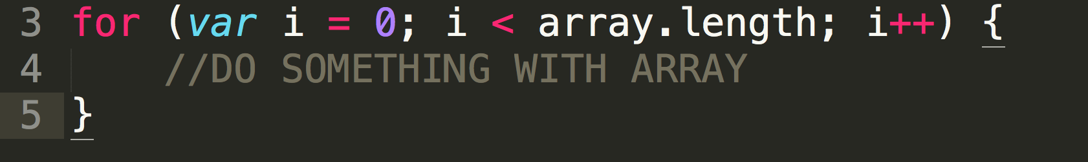
LOOPING (aka ‘For Loops’) - ARRAY
What if I wanted every value in an array?
That’s where looping kicks in!
INTRODUCING:
++ operator – Increments value by 1
-- operator – Decreases value by 1
FOR ARRAYS:
Notes:
Boxes of videos are objects or arrays
The list of names are arrays or objeccts

Slide 50
CODE-ALONG!
Notes:
Credit: https://giphy.com/gifs/gh-C6UVM5TbW1Y2s

Slide 51
PRACTICE – 5 Min.
Go to repo
Open main.js
1. Write a ‘for’ loop that logs every item in the beyonceSongs array.
2. Write a ‘for’ loop that logs every item in the beyonceMovies array.
Notes:
I do the first
Someone tells me how to do the second

Slide 52
YOUR TURN (5 min)
1. Write a ‘for’ loop that logs every item in the govtDepartments array. (If you want another challenge – make the first letter of each element lowercase)
Hint: Check out: String.toLowerCase() - http://www.w3schools.com/jsref/jsref_tolowercase.asp
2. Write a ‘for’ loop that adds 2 to every item in the numberArray and pushes the new number to a new array. Console.log the new array to check it worked!
Hint: Take a look at Array.push() - http://www.w3schools.com/jsref/jsref_push.asp
Hint: You may want to declare a variable outside the loop
3. Challenge: Write a ‘for’ loop that logs every item in the beyonceSongs array in reverse order.

Slide 53
SHOW/TELL ME YOUR CODE!!!
Notes:
Use Sublime
Credit: https://giphy.com/gifs/cheer-cheering-11sBLVxNs7v6WA

Slide 54
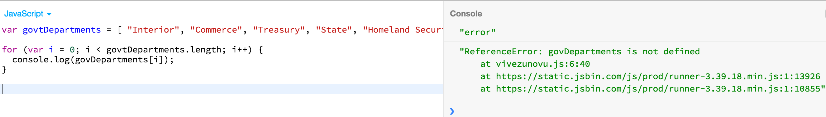
Tell me my mistake!

Slide 55
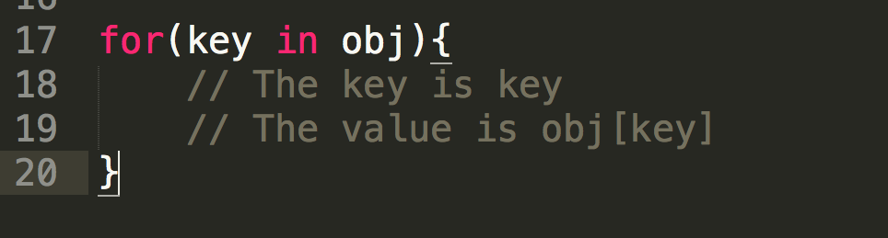
LOOPING (aka ‘For-In’) - OBJECT

Slide 56
PRACTICE
Go to repo
Open main.js
1. Write a ‘for’ loop that logs every key in lemonadeAlbum.
2. Write a ‘for’ loop that logs every value in lemonadeAlbum.

Slide 57
CODE-ALONG!
Notes:
Credit: https://giphy.com/gifs/gh-C6UVM5TbW1Y2s

Slide 58
PRACTICE – for YOU!
Go to repo
Open main.js
1. Write a ‘for’ loop that logs every key in phoneBook.
2. Write a ‘for’ loop that logs every value in phoneBook.

Slide 59

BREAK!! – 10min
Notes:
Credit: https://giphy.com/gifs/beyonce-we-like-to-party-dancing-9pcASxfqgNa5G

Slide 60

Notes:
Credit: https://giphy.com/gifs/bfv-braxtons-towanda-traci-3o7TKJbg9tcu3OkF7a

Slide 61

FUNCTIONS
Reusable statement or group of statements
Can be called anywhere within the program
DRY – Don’t repeat yourself
Use keyword ‘function’
Must be defined first → Called (usually) – when writing code
Notes:
DRY - never write the same code twice
Credit: https://giphy.com/gifs/excited-family-guy-stewie-griffin-7eAvzJ0SBBzHy

Slide 62
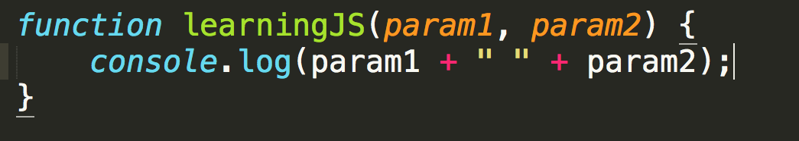
FUNCTIONS
4 Parts:
1. Keyword ‘function’
2. Name of the function (Optional)
3. Parameters (Optional)
4. Code inside the function (Optional)
Notes:
Context – I put optional by the name of the function because as you progress in JS you will find yourself potentially using anonomyous functions
And technically the code inside the function is optional because the computer will still run your function even if you tell it to do nothing but
Typically you want to name your functions and you want there to be code inside

Slide 63
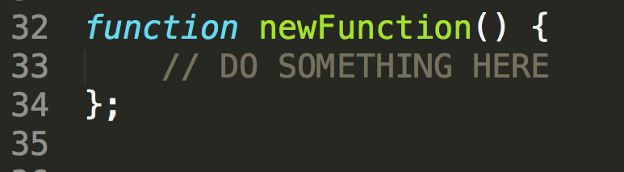
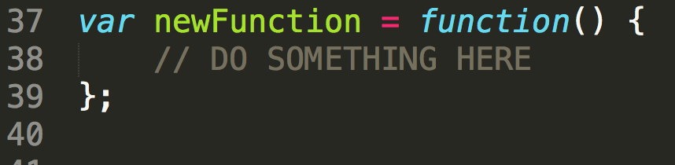
FUNCTIONS
DECLARATION
Expression
Names the function within the definition
Declares variable to name the function

Slide 64
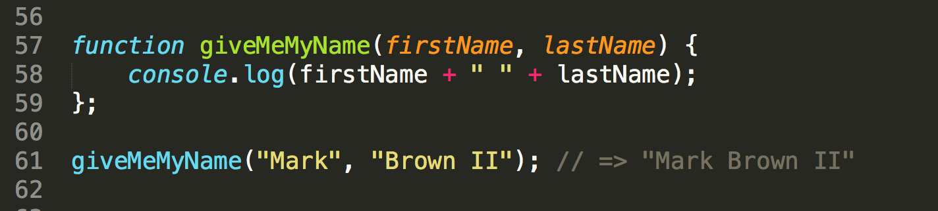
FUNCTIONS – Calling and Parameters
Write parameters in initial function definition
Pass in those values to function when calling it
Functions are called by () directly after their defined name
Uses those values in its computation
Notes:
Similar to variables – you define functions (declare variables) – and then you call them
Can have any number of parameters in a function
Parameters are in the definition
Arguments are the values you pass in

Slide 65
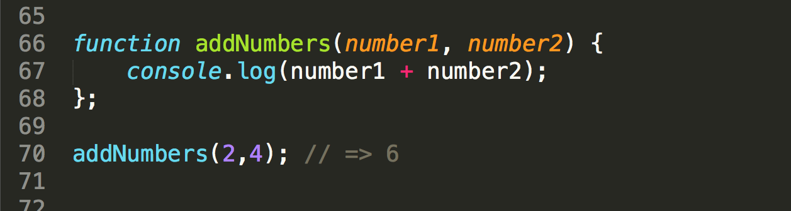
FUNCTIONS – Calling and Parameters
Notes:
Go to JSBIN
Do function subtractNumbers(num1, num2) {
console.log(num1 – num2)
}
subtractNumbers(7,3);

Slide 66
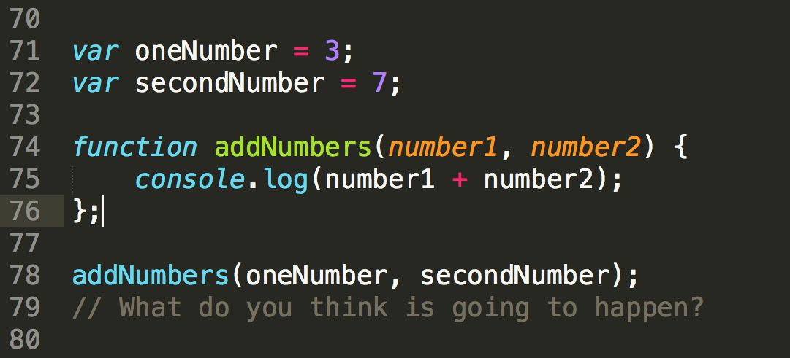
FUNCTIONS – Calling and Parameters
Notes:
Who wants to give me another way of writing this function WITHOUT using parameters?

Slide 67
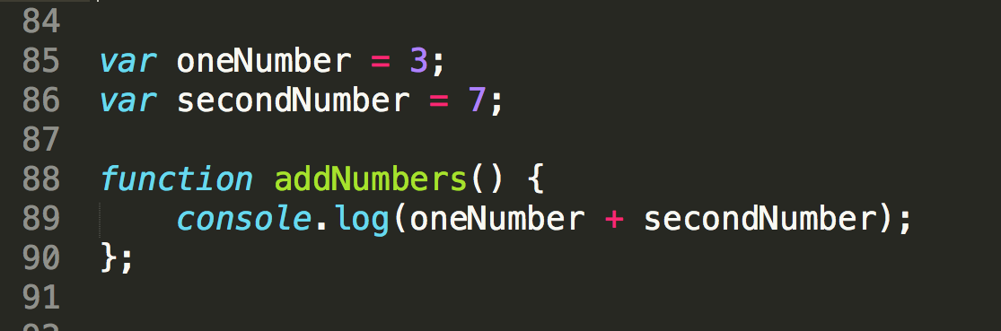
FUNCTIONS – Calling and Parameters
Notes:
Why parameters work? Because they allow you to re-use code. If you didn’t use parameters you would have to copy and paste this code somewhere else with other variable names – which is NOT DRY (do not repeat yourself).

Slide 68
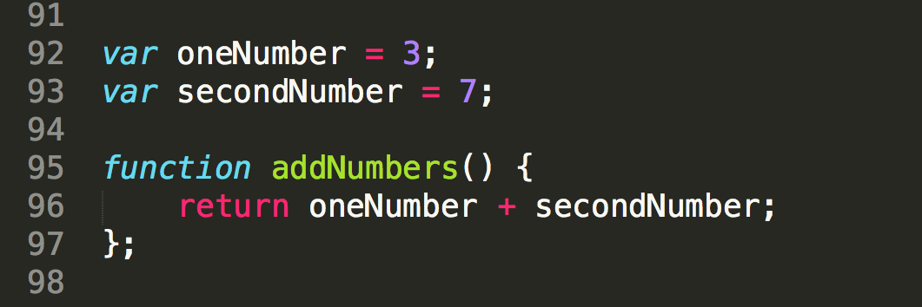
FUNCTIONS – keyword ‘return’
Returns the value of your function’s computation to the function’s moment of execution
‘return’ stops the function’s execution
Notes:
Not the same as console.log – console.log prints the information to the console
Return passes the value back to the function for future use

Slide 69
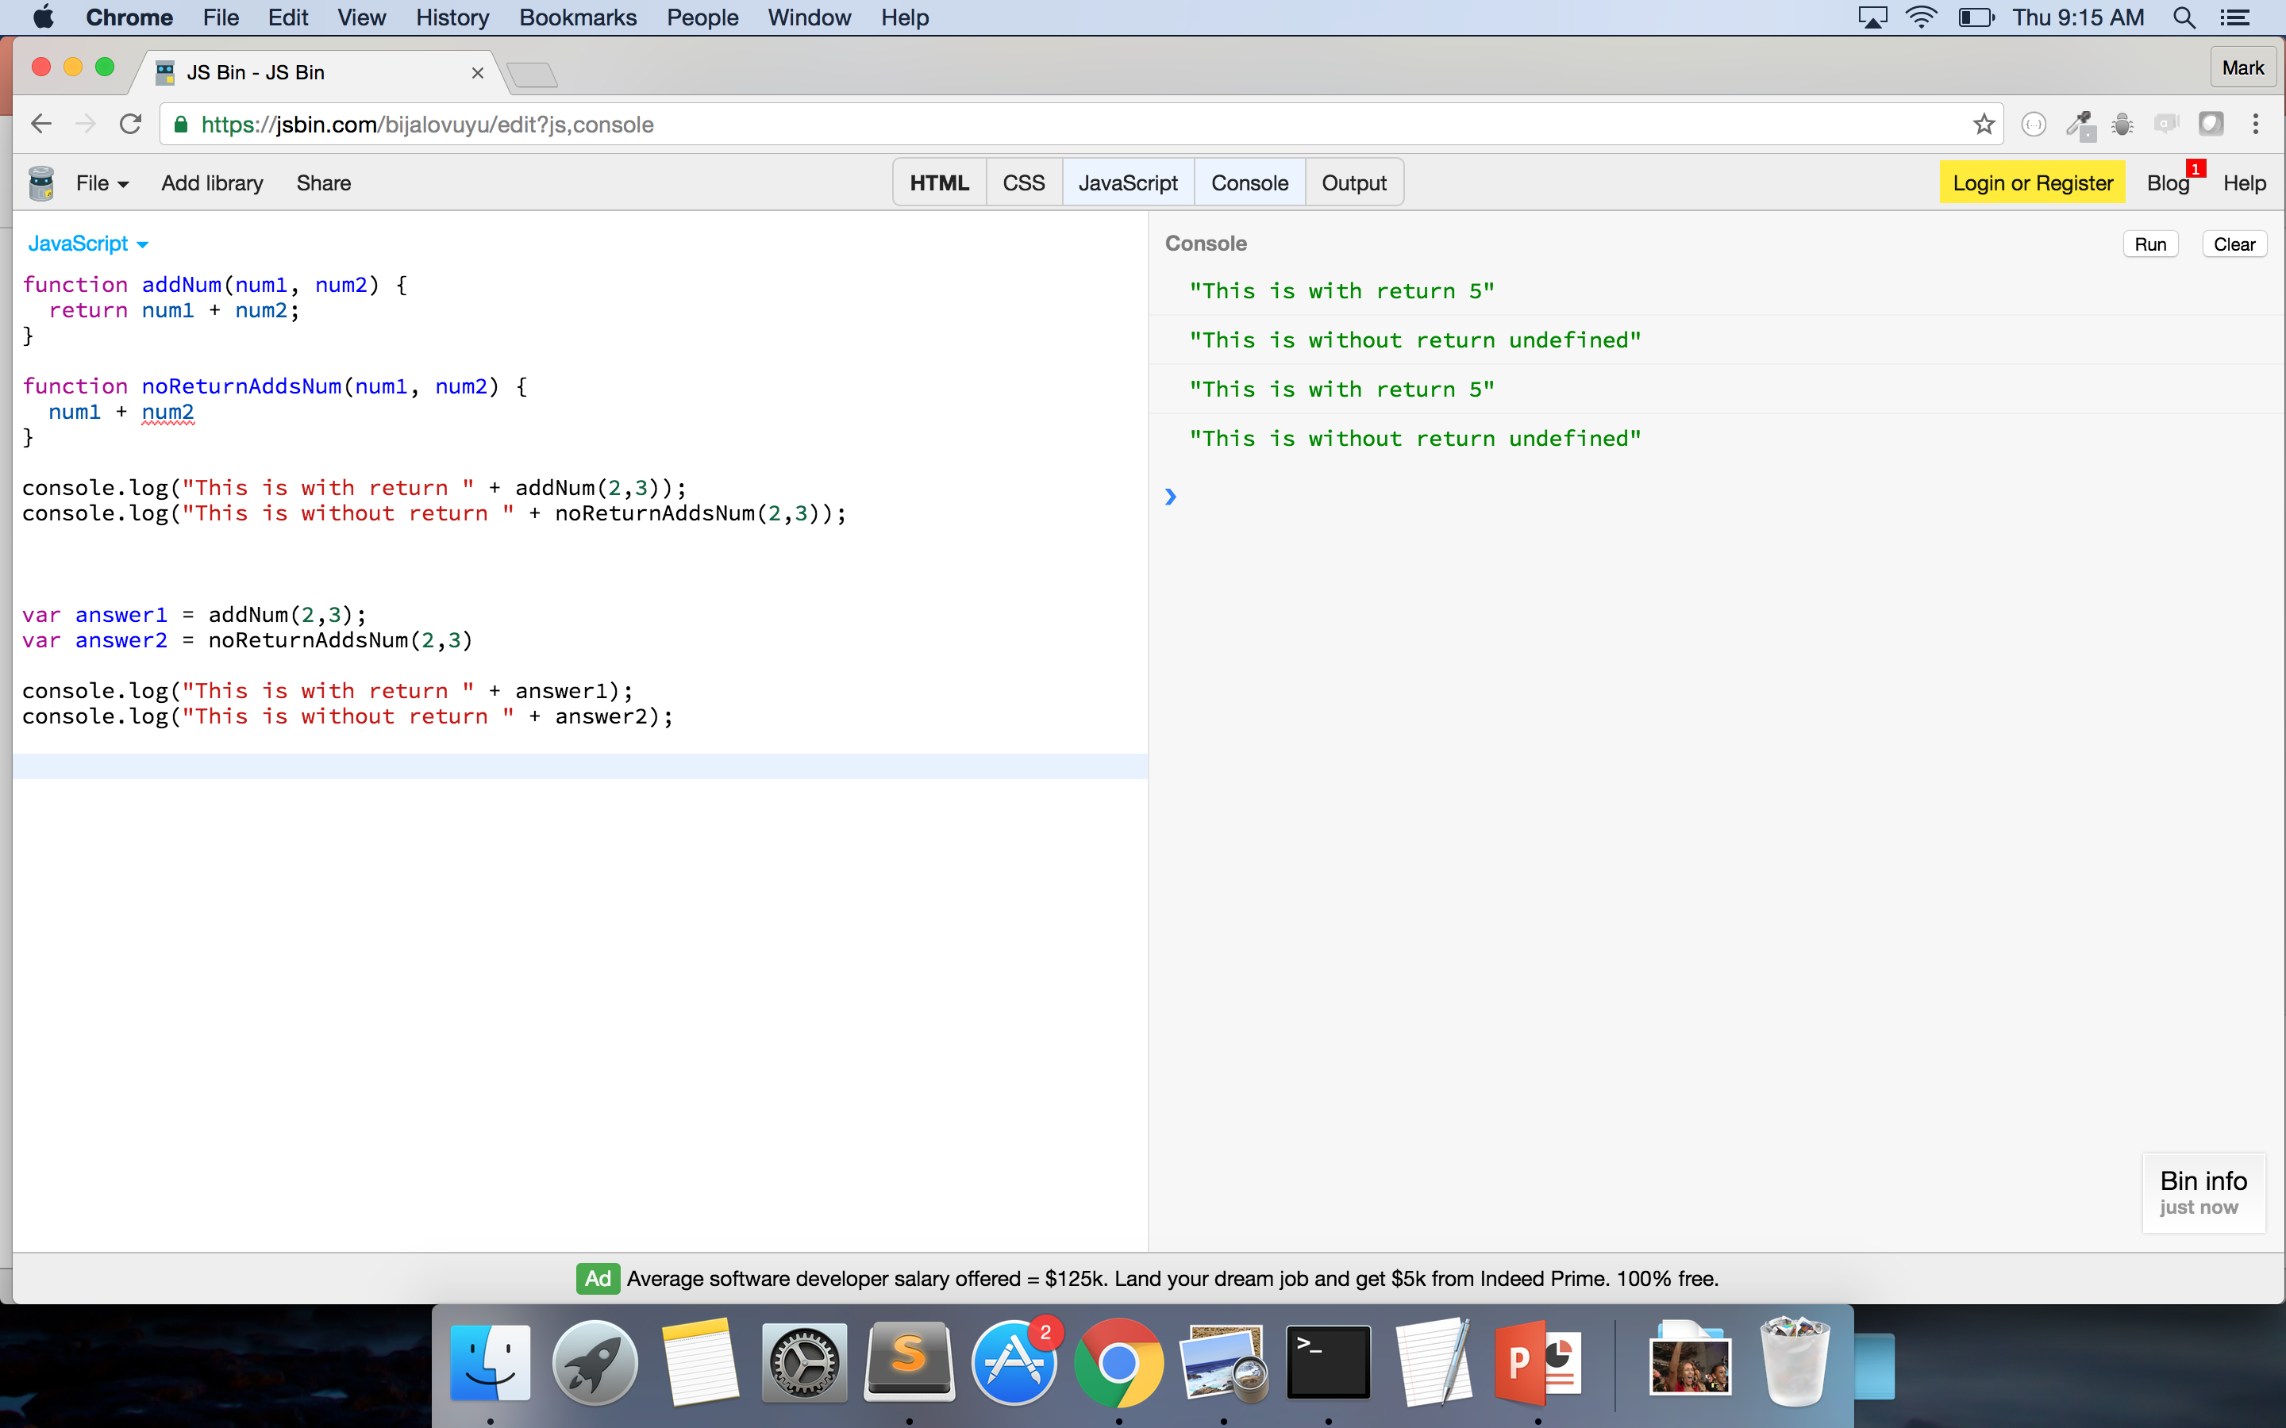
Notes:
DON’T TALK ABOUT CONSOLE VS RETURN
With first function return passes the value back
In the second – the function is performed but nothing is passed back – or returned – so the console prints undefined

Slide 70
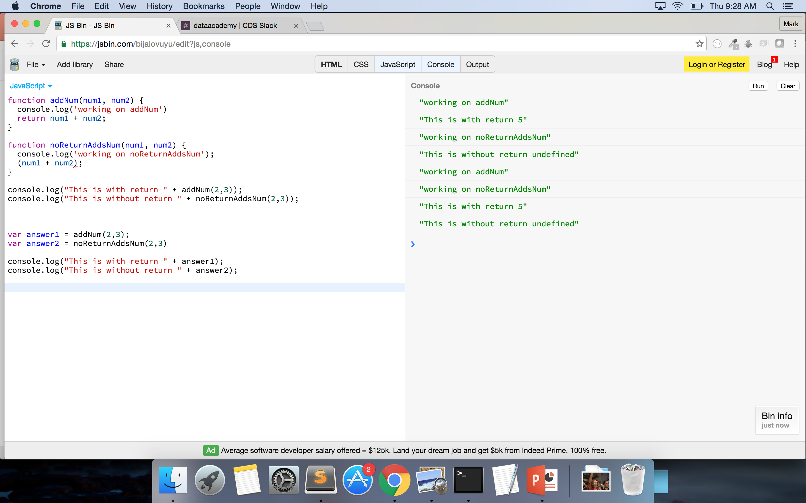
Notes:
Just to make sure the functions are working I’ve added in a console.log statement

Slide 71
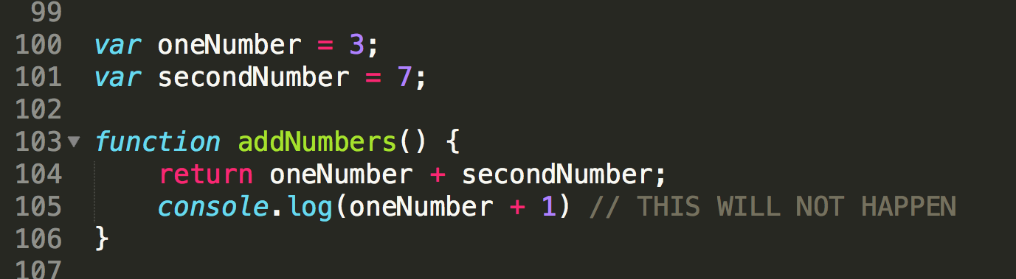
FUNCTIONS – keyword ‘return’
Notes:
With the keyword ’return’ the function stops as soon as it hits it – WHY?

Slide 72
JAVASCRIPT IS NATIVELY
SYNCHRONOUS!!

Slide 73
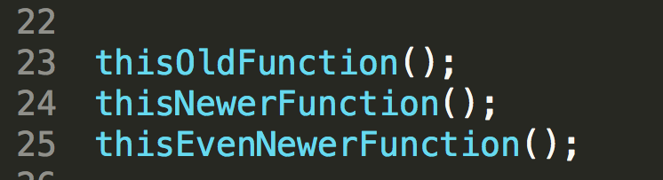
FUNCTIONS - Synchronous
Notes:
JS is Synchronous: http://stackoverflow.com/questions/2035645/when-is-javascript-synchronous

Slide 74
FUNCTIONS – keyword ‘return’
Notes:
With the keyword ’return’ the function stops as soon as it hits it – WHY?

Slide 75
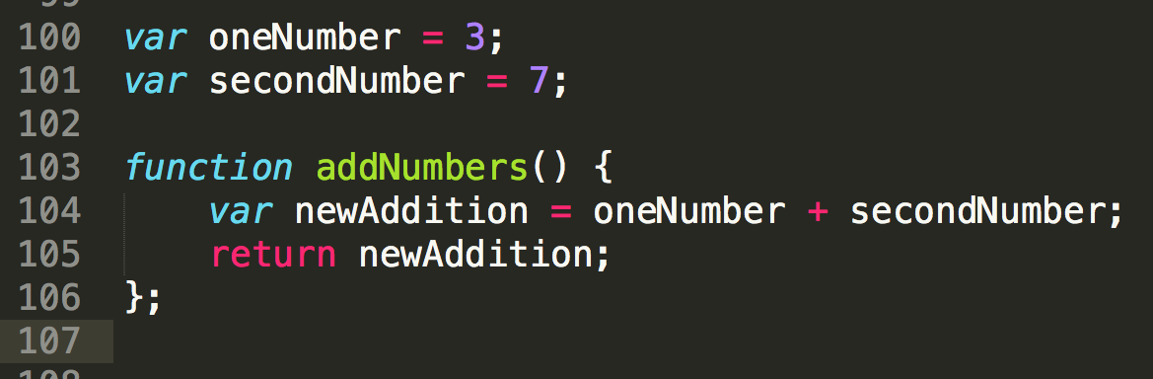
FUNCTIONS – keyword ‘return’
Notes:
Why would one say that this code could be better?
- use of variables rather than parameters

Slide 76
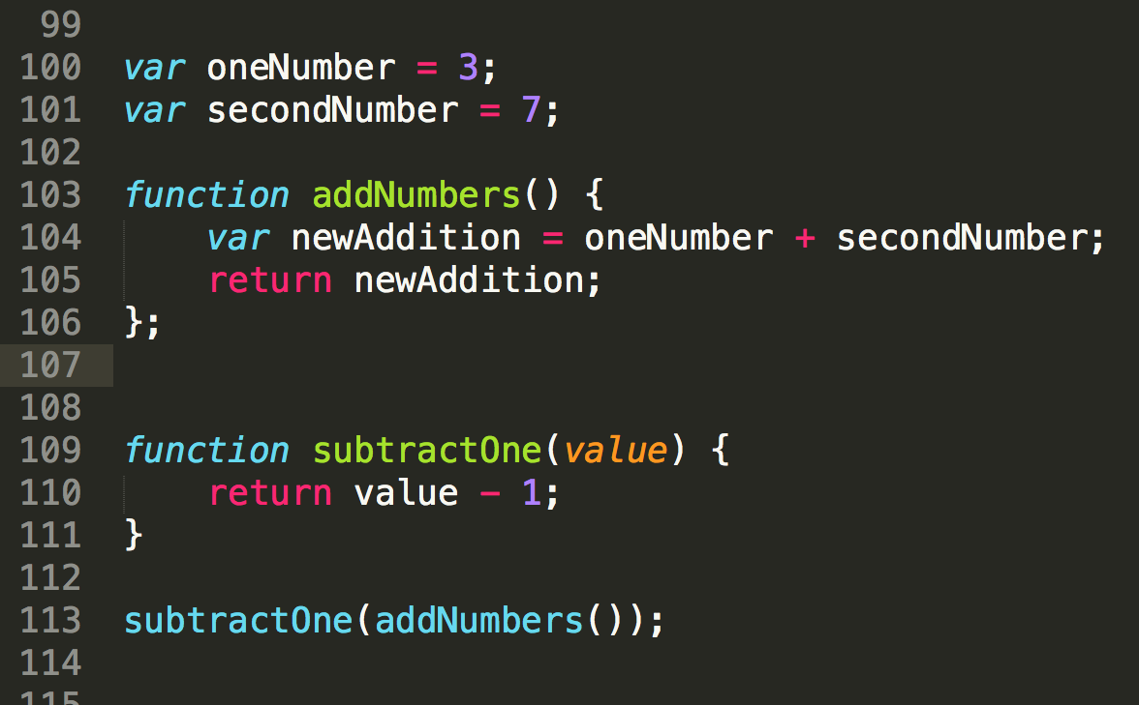
FUNCTIONS
Notes:
Can pass functions to other functions – THIS IS WHEN IT GETS FUN
Still follows traditional math setup – evaluates what is inside first – and then works outward
WHY DO YOU THINK WE DO THIS? Allows us to not have to re-write code if something needs to be changed
Makes our code much cleaner to read
TO BE CLEAR – the ‘return’ statement doesn’t function exactly like console.log
- console.log shows the information passed into it onto the console
- return passes back the value of the function
- console.log is for debugging and ’return’ is for programming

Slide 77
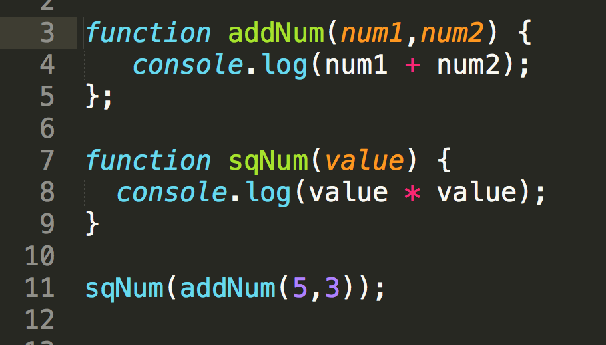
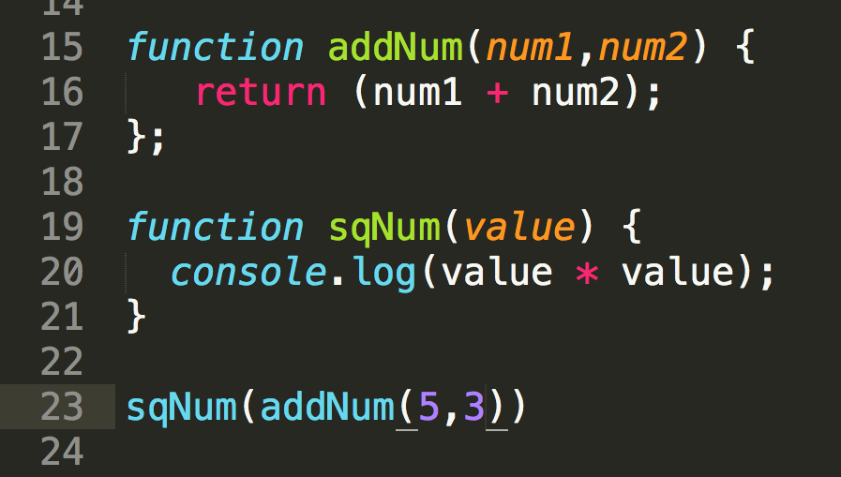
FUNCTIONS – keyword ‘return
Notes:
RETURN VS CONSOLE.LOG
Console.log – logs information to the console – does not pass the value back to the function call
Return – passes the information back to the function call which you can then reuse in other functions or assign to variable

Slide 78
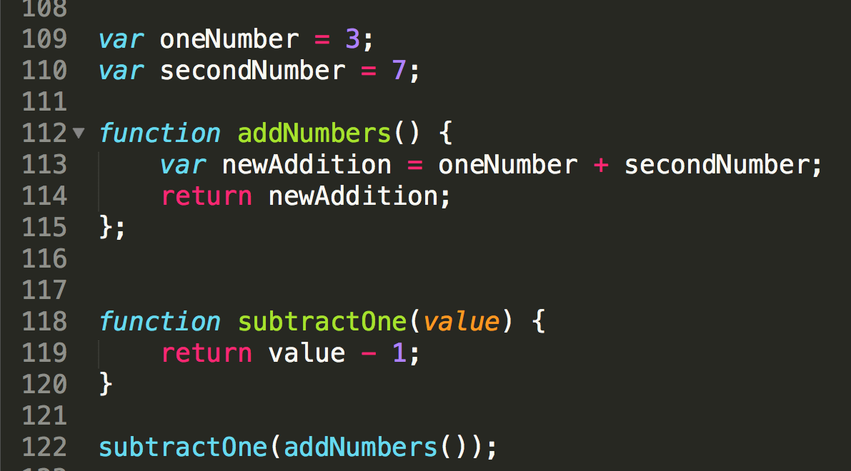
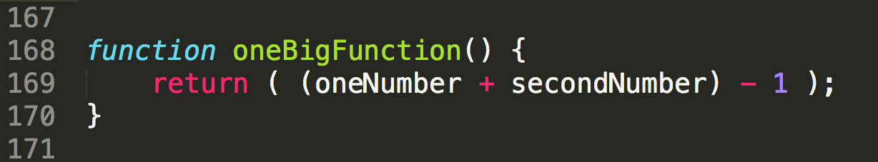
FUNCTIONS - Readability
Break down complex tasks
Readability
Lessens margin of human error
Allows for code flexibility
Allows for code reuse
Notes:
Less code doesn’t always mean better code and doesn’t make you a better developer – think about teammates and future developers
Can you reuse the second one? But couldn’t you reuse the subtractOne function somewhere else?
If someone wanted you to subtract 1 and then multiply it by 3 – imagine how the second function will look vs. updating the first

Slide 79
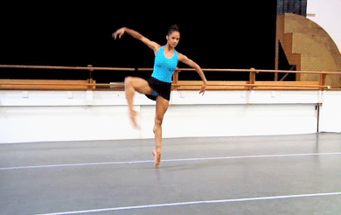
CODING OBSERVATION
Coding is FLEXIBLE!
Different code by different people can have same result!!
Not all code has to, or will, look alike!

Slide 80
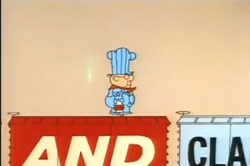
FUNCTION PRACTICE! (with me)
1. Write a function that console.log’s your name. (Remember to pass in a string!)
2. Write a function that will square any number passed into it.
3. Write a function that will take a value and add it to an array that is outside the function.
Notes:
Use the array moment to re-introduce the synchronous nature of JS
var emptyArray = [];
function addValue(value) { emptyArray.push(value);}
addValue(3);
addValue(7);
addValue(15);
console.log(emptyArray); → [3,7,15] – JS went in order rather than random

Slide 81
CODE-ALONG!
Notes:
Credit: https://giphy.com/gifs/gh-C6UVM5TbW1Y2s

Slide 82
FUNCTION PRACTICE!
1. Write a function that will return the name of an animal you pass in.
2. Write a function that will divide the number you pass in by 5.
3. Write a function that will console.log the values of any object. Use object captainPlanet to check your fxn.
4. Write a function that will add 1 to every element of an array that is passed in. Use addMeUp to check your fxn.
5. Write a function that will tell me the dataType of every element in an array that is passed in. Use mixedUpTypes to check your fxn.

Slide 83

Remember – YOU CAN DO THIS!
Notes:
Credit: https://giphy.com/gifs/beyonce-hair-flip-11wsZr0jbXc15m

Slide 84
FUNCTION PRACTICE!
1. Write a function that will return the name of an animal you pass in.
2. Write a function that will divide the number you pass in by 5.
3. Write a function that will console.log the values of any object. Use object captainPlanet to check your fxn.
4. Write a function that will add 1 to every element of an array that is passed in. Use addMeUp to check your fxn.
5. Write a function that will tell me the dataType of every element in an array that is passed in. Use mixedUpTypes to check your fxn.
Notes:
WRITE THE ARRAYS AND OBJECTS FOR THESE EXERCISES

Slide 85

OMG POP QUIZ!
1. What’s the difference between a float and integer?
2. True/False: You can only get the value from an object using dot.notation. e.g. object.key = value
3. What are 2 major differences between arrays and objects?
4. What’s another name for JavaScript?
5. True/False: JSON is a group of arrays.
6. True/False: Functions must always take a parameter.
7. True/False: Less code is always better code.
Notes:
Credit: https://giphy.com/gifs/surprise-fabulous-pajamas-A5F11Cbo7b8cw

Slide 86
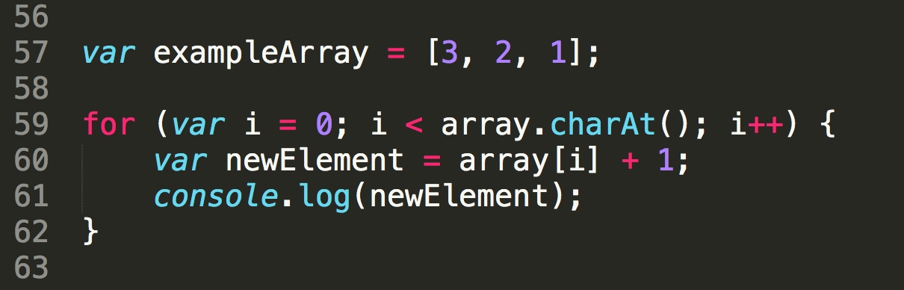
WHAT’S WRONG?
Notes:
Wrong array name
Array.length

Slide 87
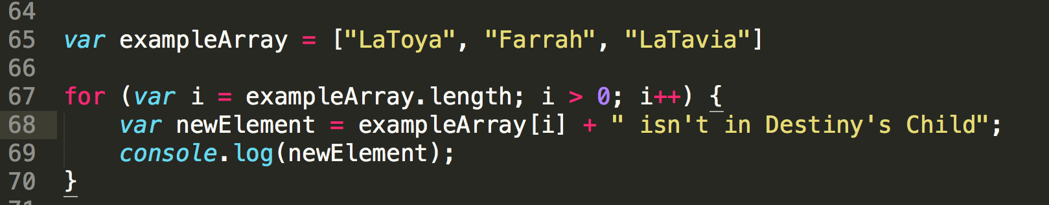
WHAT’S WRONG?
Notes:
How we instantiate the variable i

Slide 88
Resources for Continued Learning
Code School (www.codeschool.io)
Eloquent JavaScript (http://eloquentjavascript.net/)
Pluralsight (https://www.pluralsight.com)
Udacity (https://www.udacity.com/)

Slide 89
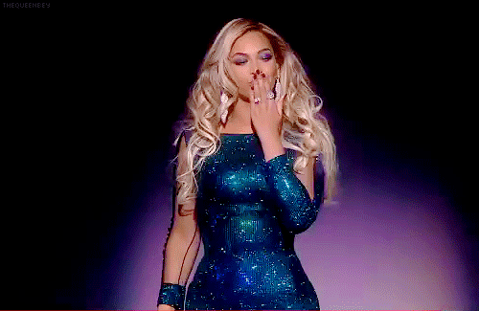
THANK YOU FOR COMING!
Hope you had as much fun as I did!!
Notes:
Credit: https://giphy.com/gifs/kim-kardashian-gif-simcity-buildit-QCevNzgfKTigg

